Slide 1
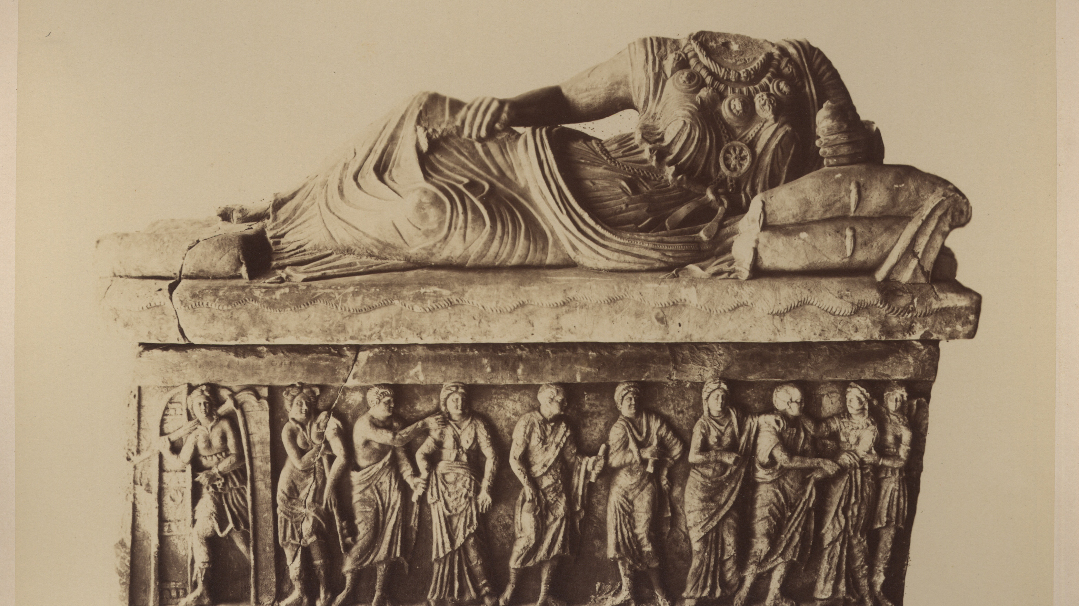
Partizione Antica
Enrica Zani
University of Bologna (former student)
PHAROS: The International Consortium of Photo Archives
Digital Art History Projects Showcase
November 8, 2023
Looking for a XIXth century art historian

Slide 2
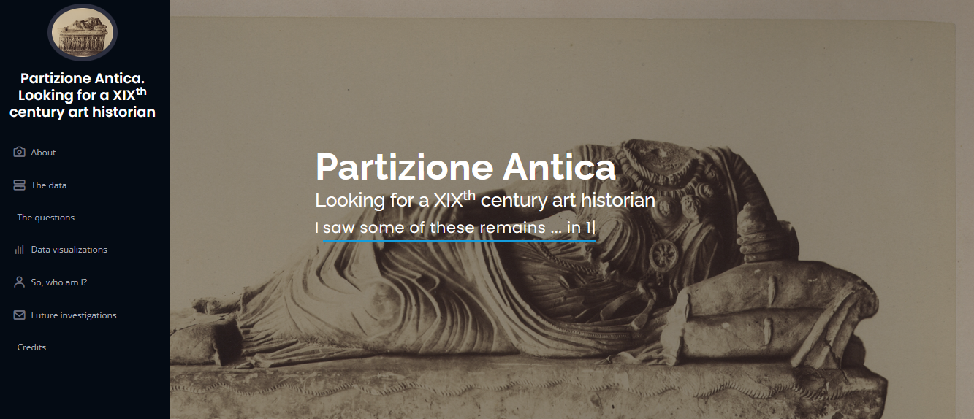
Website project
Disclaimer:
All the images are shown for illustrative and didactical purposes only.
Images: CC-BY-NC credits to Biblioteca delle Arti. Sezione di Arti visive "I. B. Supino". Alma Mater Studiorum Università di Bologna
OA and F entries: CC-BY-NC credits to Fondazione "Federico Zeri"
Website: https://enri-ca.github.io/EPDS_EZ
Github repository: https://github.com/enri-ca/EPDS_EZ
Jupiter Notebook https://github.com/enri-ca/EPDS_EZ/blob/main/EPDS_EZ.ipynb

Slide 3
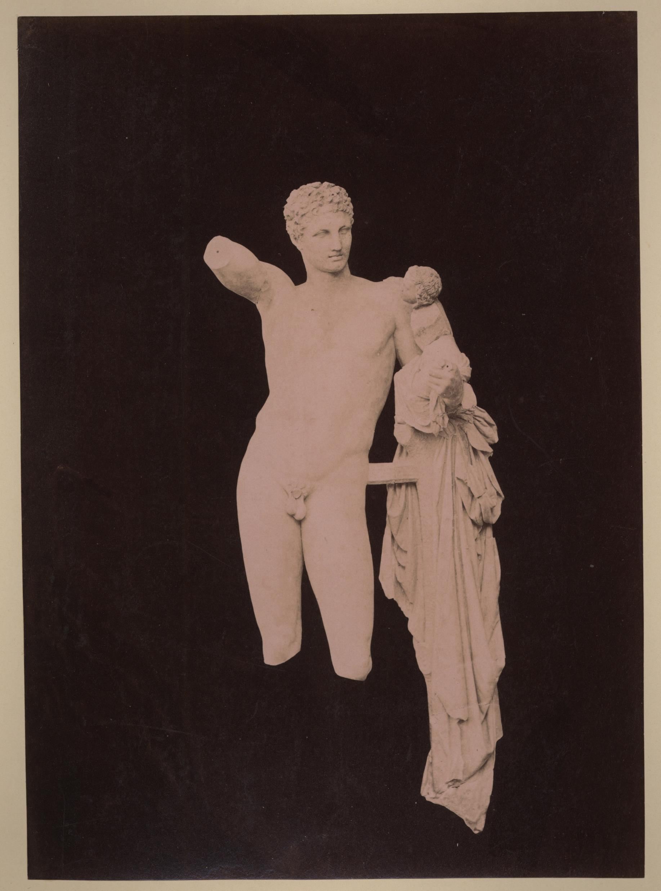
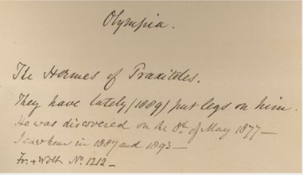
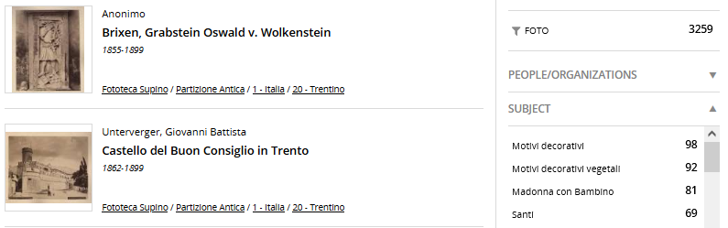
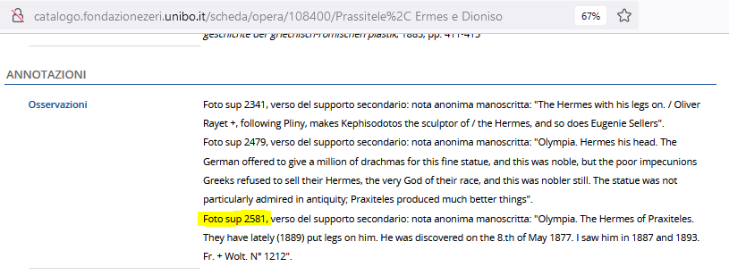
About
Anonimo <1855-1920>. 1877. [Ermes Di Praxiteles : Museo Archeologico : Olimpia. sup 2581 - PA Grecia II 040
The Partizione Antica is a series counting about 3000 photographs of the Fondo Supino art photo archive belonging to the Biblioteca delle Arti (Università di Bologna)
The photographs often carry on the verso side, handwritten annotations in English from the same hand
The photos have been described according to scheda F and OA models: the metadata and the digitalization of the photos are accessible from the Zeri Fundation catalogue
Annotations are partially transcribed in OA entries
The series has been quite well studied and treated in the past
But the original collector identity remains unknown
Notes:
Charles Newton, Wolfgang Helbig, George Dennis, Eugénie Sellers Strong, Phil Perkins, John Ruskin, Heinrich Schliemann, etc

Slide 4
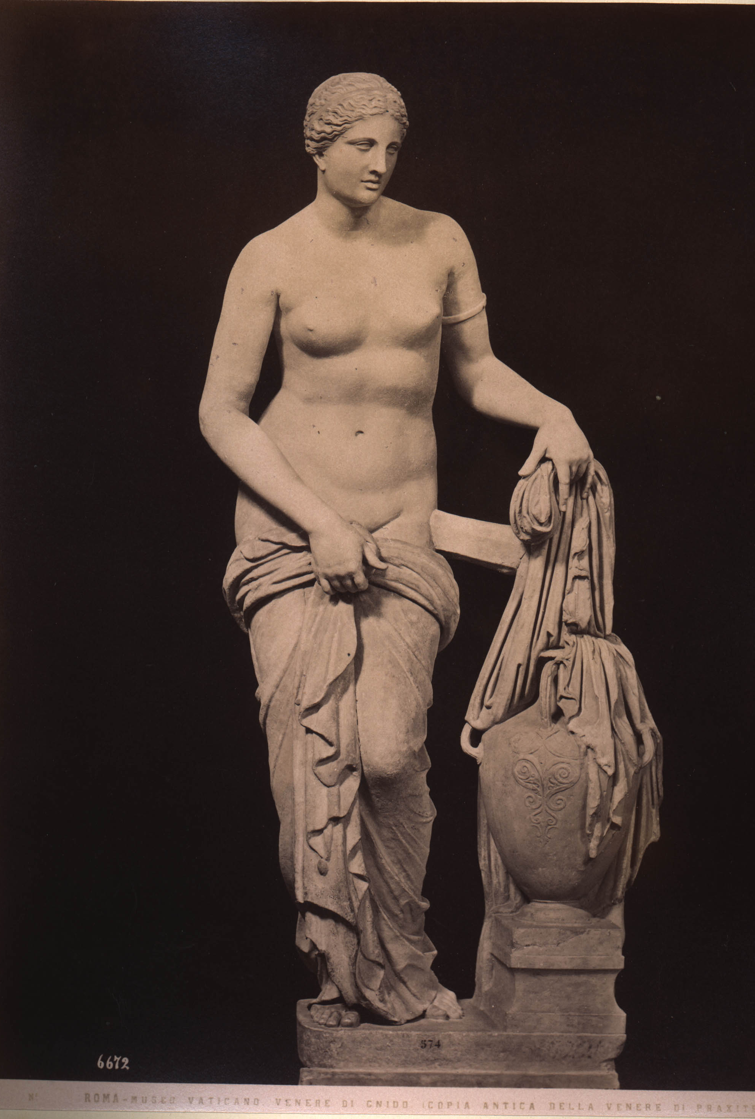
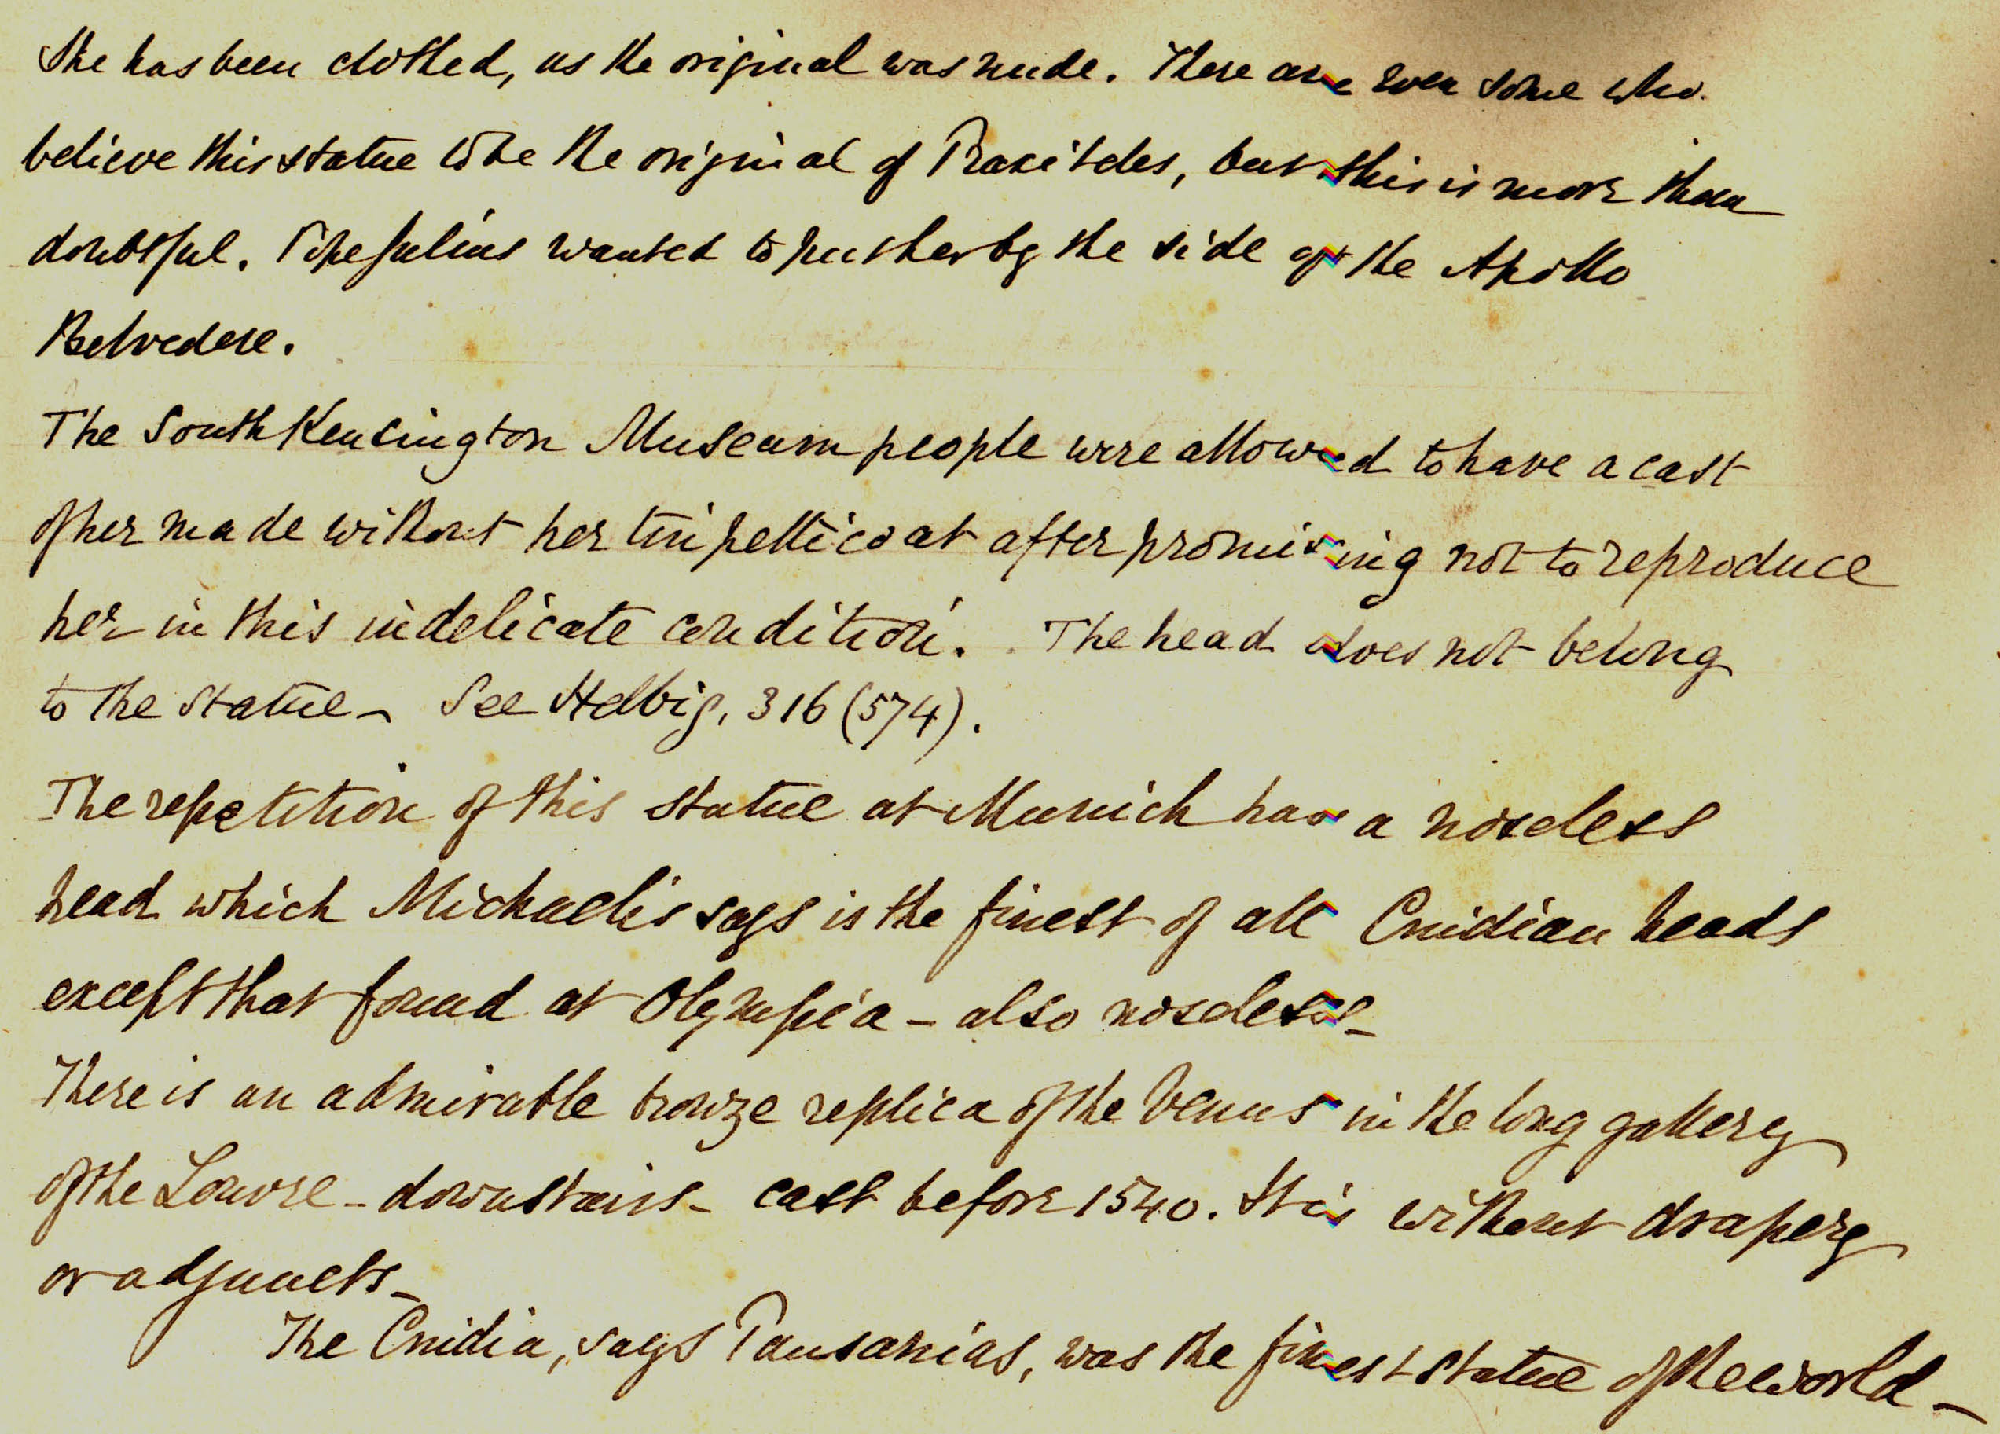
The question
Anonimo <1854-1916>. 1876. Roma : Museo Vaticano : Venere Di Cnido (Copia Antica Della Venere Di Praxitele). Alinari <Fratelli Alinari>. sup 733 - PA Roma II 063
Who is the art historian creating the “Partizione Antica”?

Slide 5
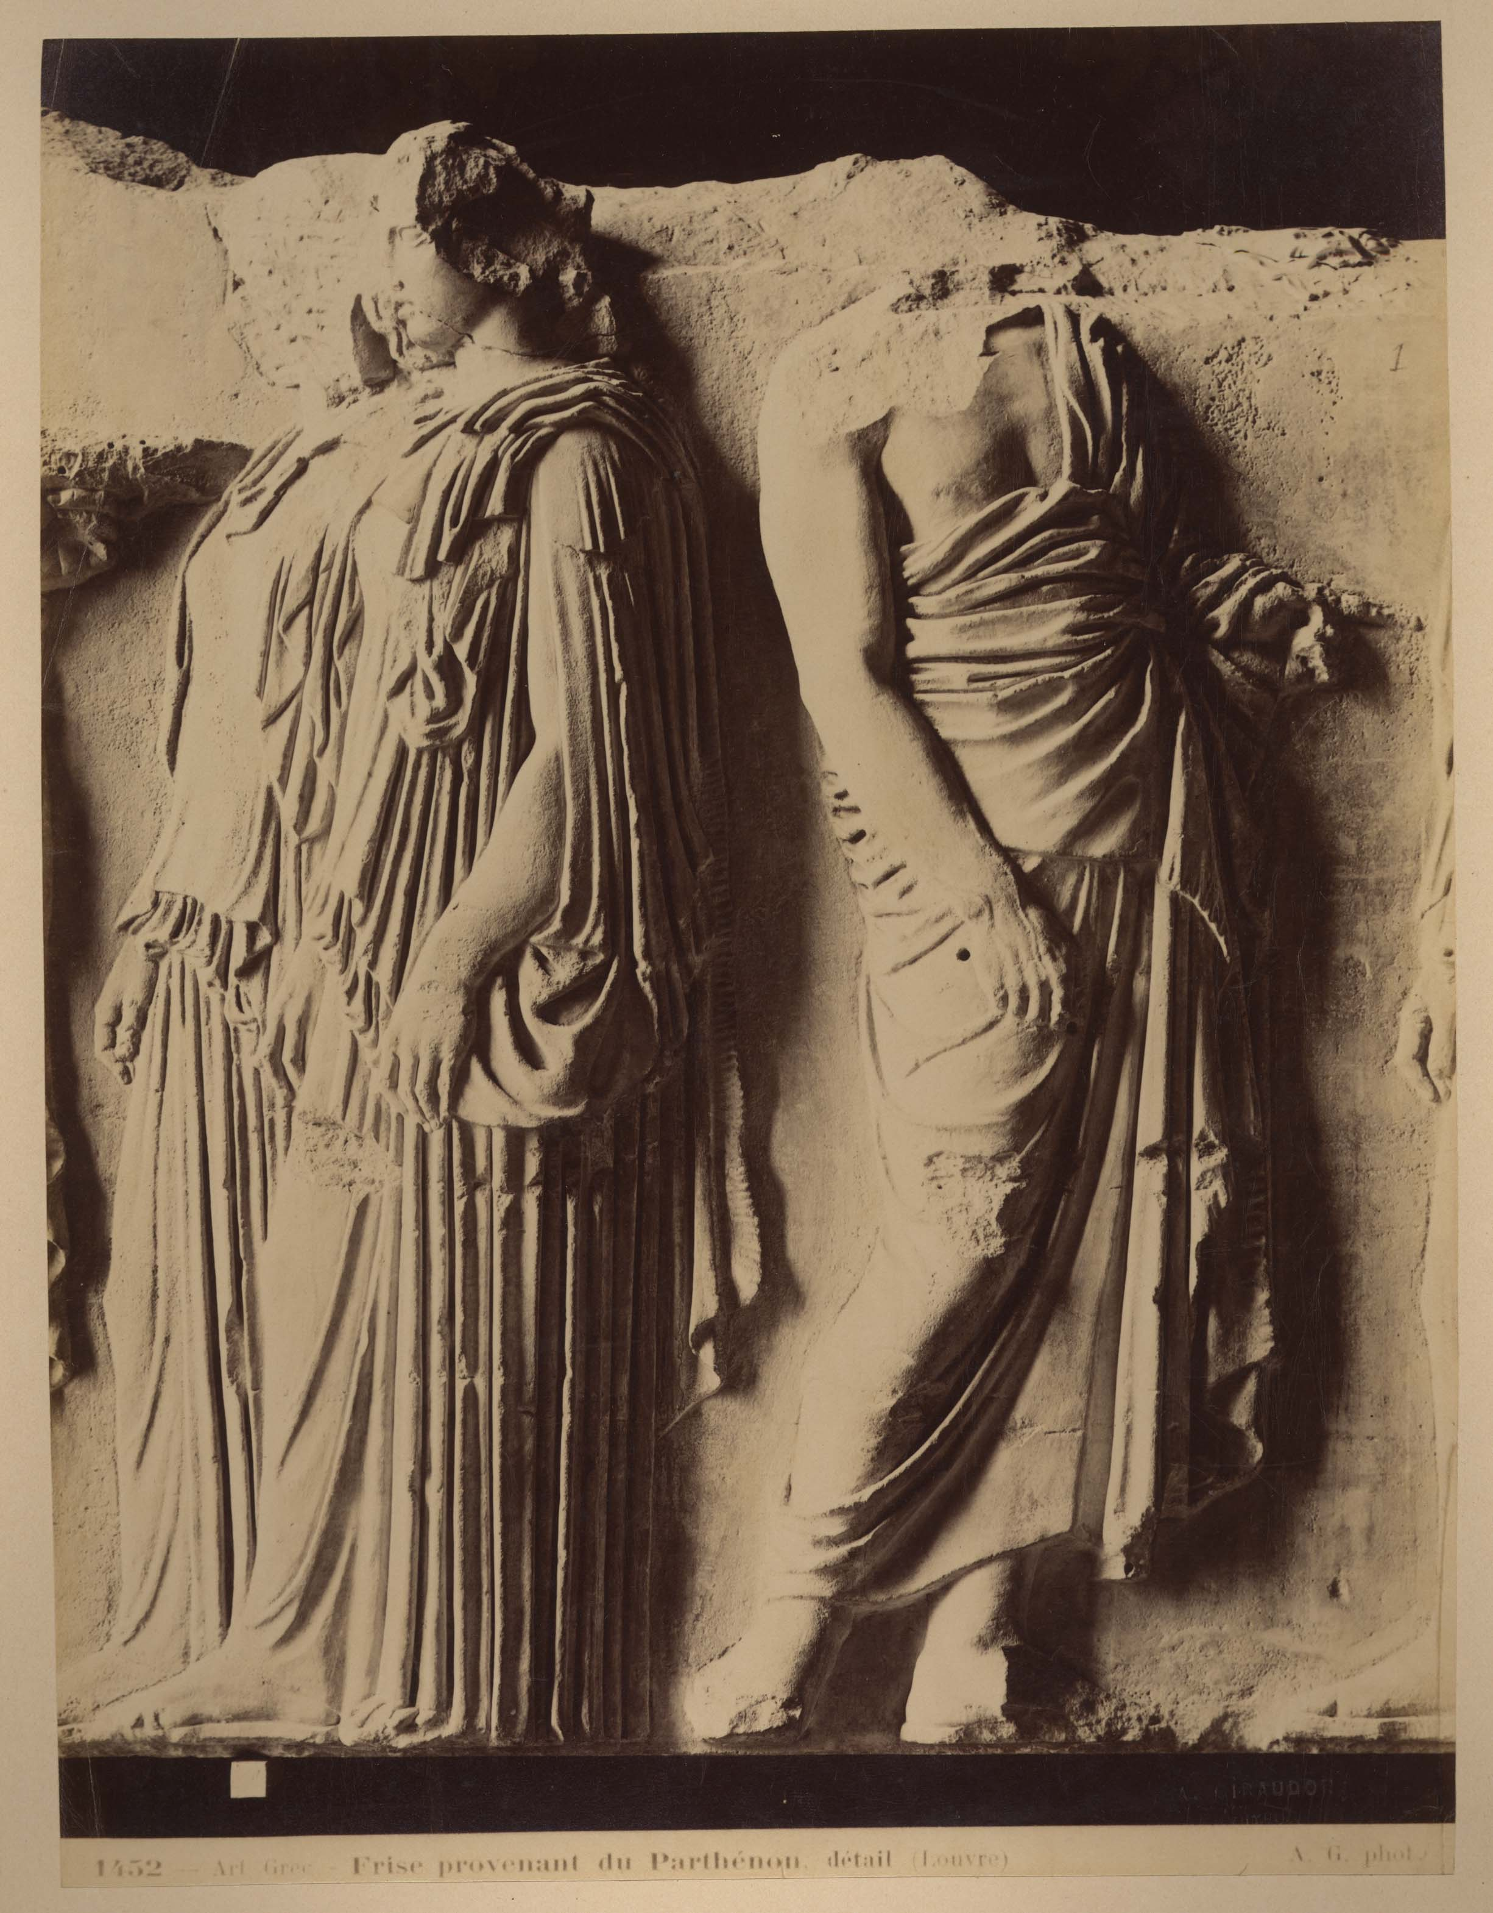
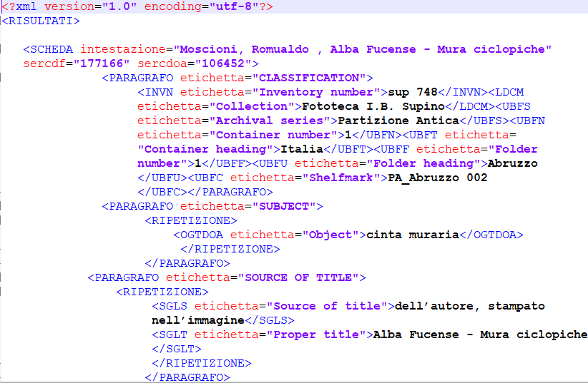
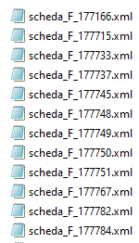
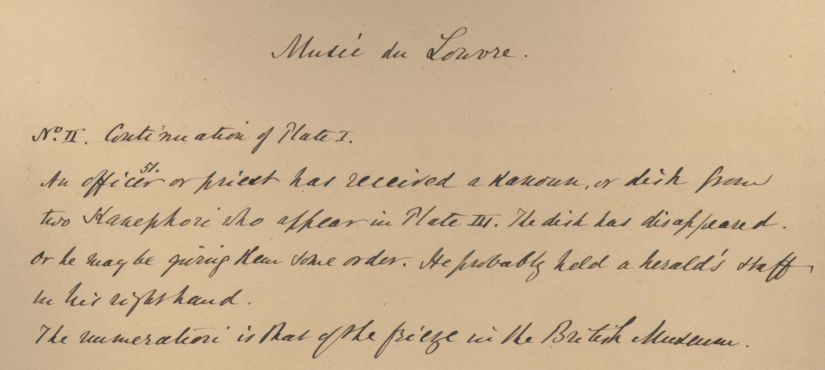
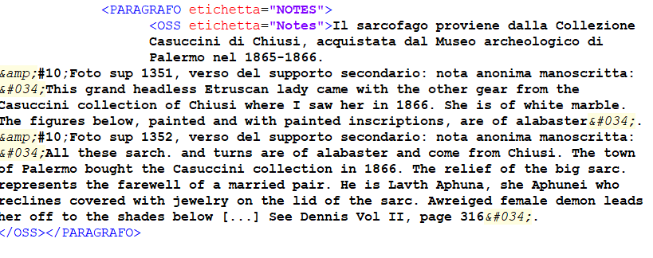
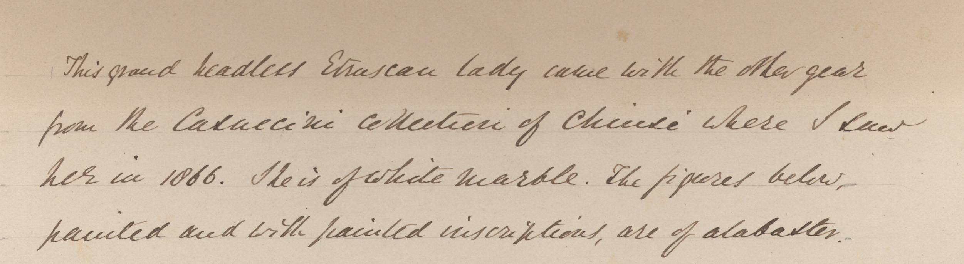
The Data
Giraudon, Auguste. 1877. Art Grec : Frise Provenant Du Parthénon, Détail (Louvre). Giraudon, Auguste. sup 2225 – PA Francia 077
Structured metadata:
- 3.232 F entries
- 2.634 OA entries
XML format from Zeri catalogue
Unstructured data (free texts):
- 1.838 free texts
transcribed annotations in OSS field of OA entries

Slide 6
Data preparation
STEPS
creation of unique xml files for all the F and OA entries extracted
extraction of relevant information for the project from nested xml structure
ISSUES/DESIDERATA:
Data extraction to be required (closed db) VS dynamic queries
Different Focus working on photographs as archival objects instead of according to a works of art point of view
Annotation transcribed in OA entries instead of in their related F entry
Need to rebuild connections between annotations and actual photo/support
extraction of unstructured annotations from OA data
creation of a new database merging data from the two previous steps
Notes:
photograph’s item level metadata, is instead reported to the work-manifestation-item level of the represented work of art in the OA entry.

Slide 7
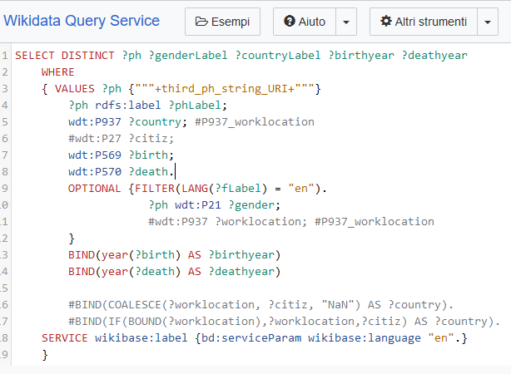
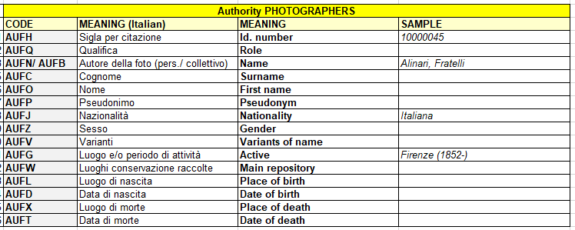

Data elaboration
STEP
Photographer: enrichment of workplace, activity timespan, VIAF number via Wikidata SPARQL queries
ISSUES/DESIDERATA:
Time saver having reference to AF identifiers (es. VIAF) in addition to just local language strings

Slide 8
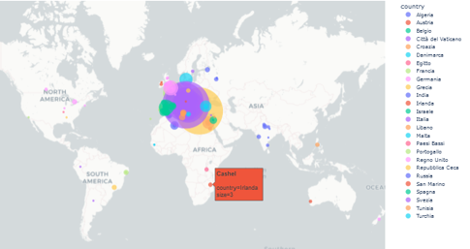
Data elaboration
STEP
Places: enhancing geolocation via geopy Python client
ISSUES/DESIDERATA:
Add geodata or Geonames ID - instead of just name strings - to source data to avoid multilingual misunderstanding and disambiguation of homonymous places

Slide 9
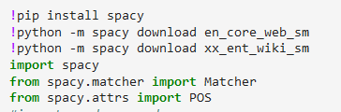
Data elaboration
ISSUES/DESIDERATA:
Annotations sample, sometimes incompleted ([…]), transcribed with a work of art focus
Best HTR to complete the corpus
Minor misspelling
Multilingual corpus
STEP
unstructured annotations: seeking for further elements running NLP and NER Python libraries

Slide 10
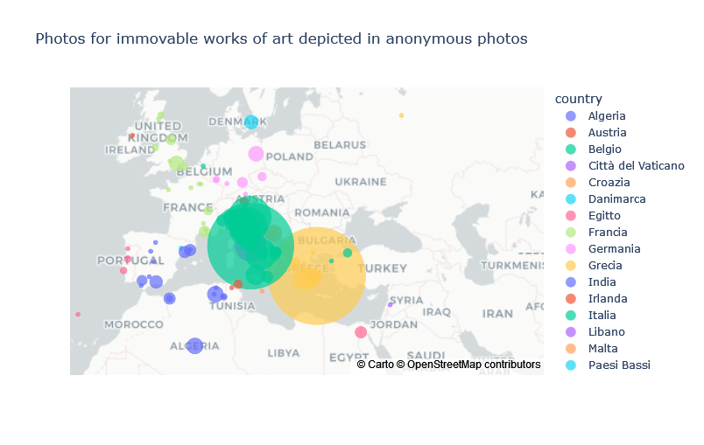
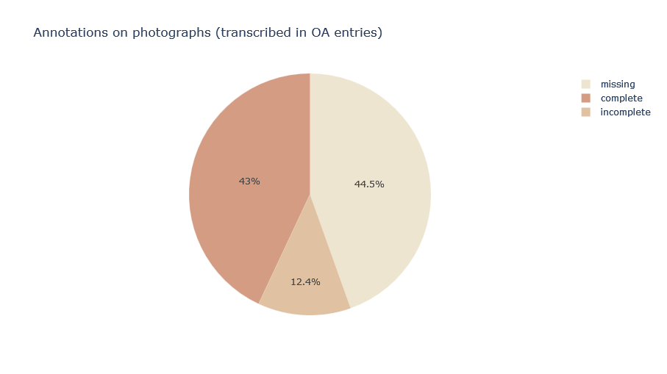

Results from structured data
already known
… and new insights
Interest for funerary sculpture and sarcophagus.
Interest in Mediterranean area
Little extra-European photos’ set (18 Indian subject)
Transcribed annotations
for more than 50% of
photographs
(1.838)
47,5% photos from relevant art history photographers (Alinari 20%, Moscioni, Brogi, Sommer 5% each, Laurent, Incorpora, Giraudon 2,5% each)
49% of anonymous photos
3,5% of photos from a big variety of other not anonymous photographers (100/111 names with less than 20 photos each)

Slide 11
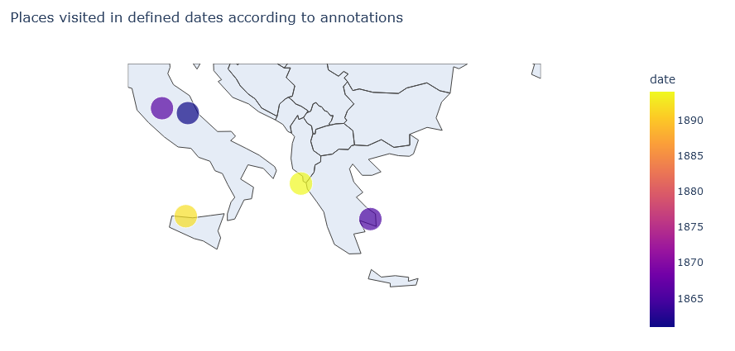



Results from unstructured texts
matcher.add("PA_creator", [[{"LEMMA": "I"}, {POS: 'VERB'}]])
= 22 occurrences
6 place-time references to personal experiences
6 ownership declarations (5/6 about medals)
10 opinions
I told the Countess Marcello (nee Grimani) that I respected her immensely on account of this statue of Agrippa. This was in Corfù in March 1894.
(sup 1811)
I have a medal of him with the inscription: / "Antonius de Royzellis monarcha sapientie"
(sup 659)

Slide 12
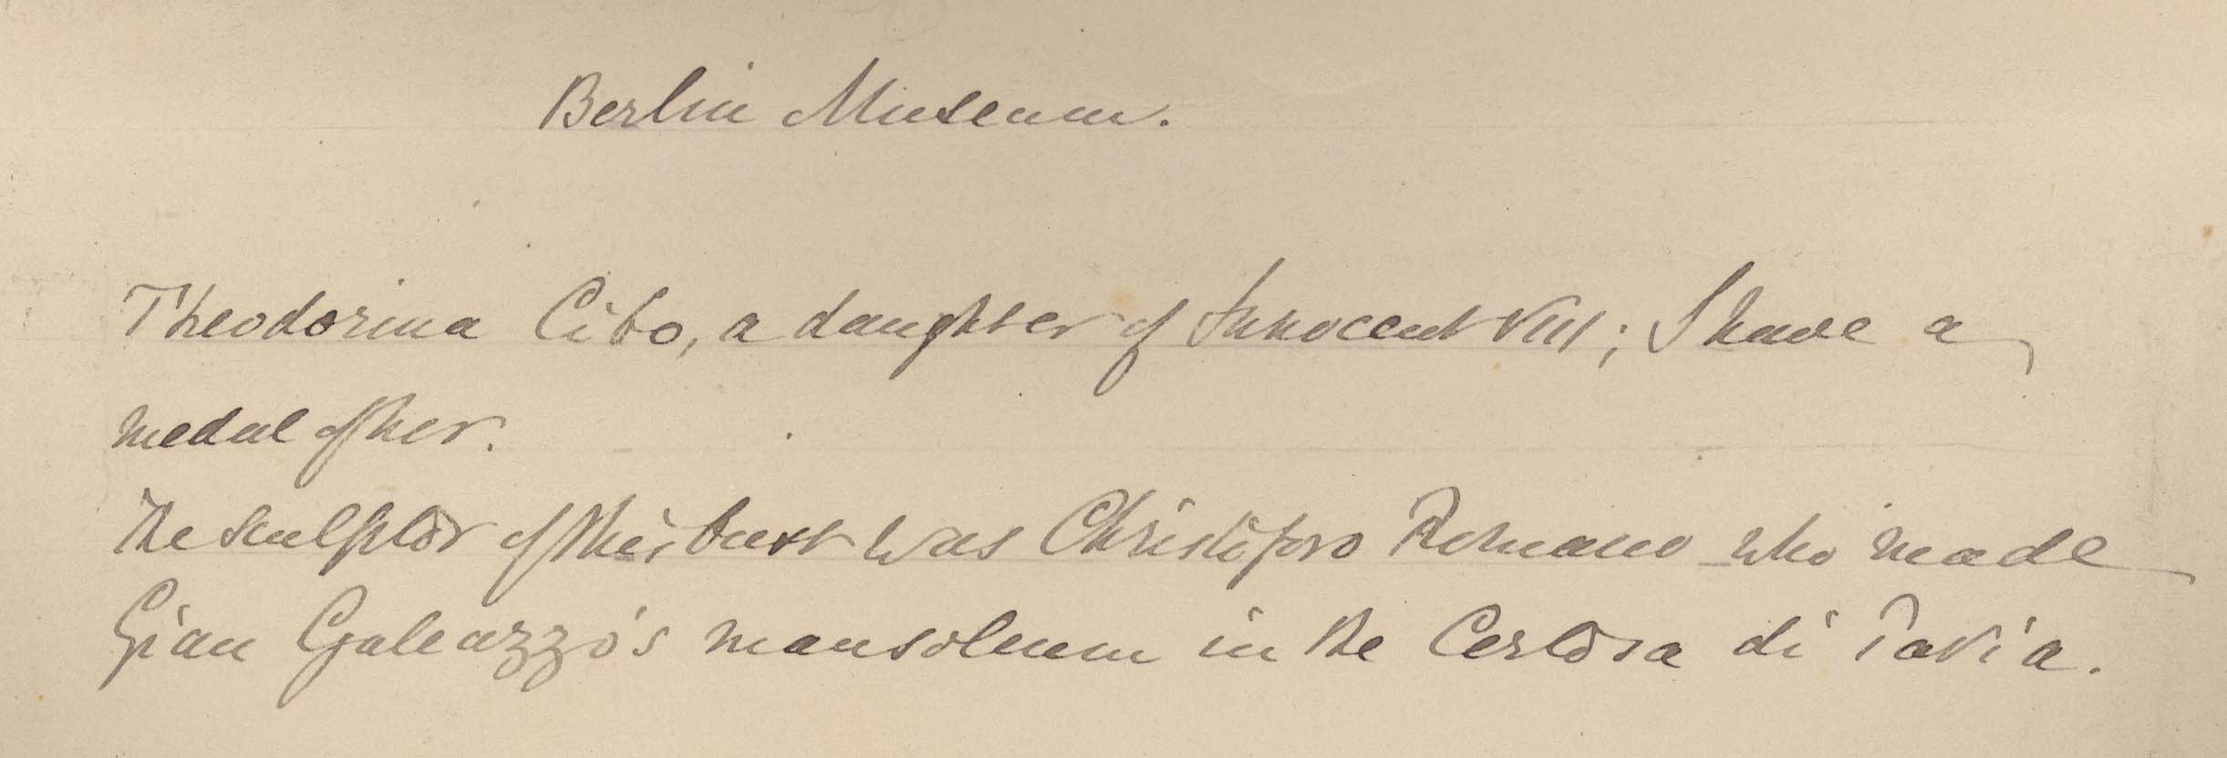
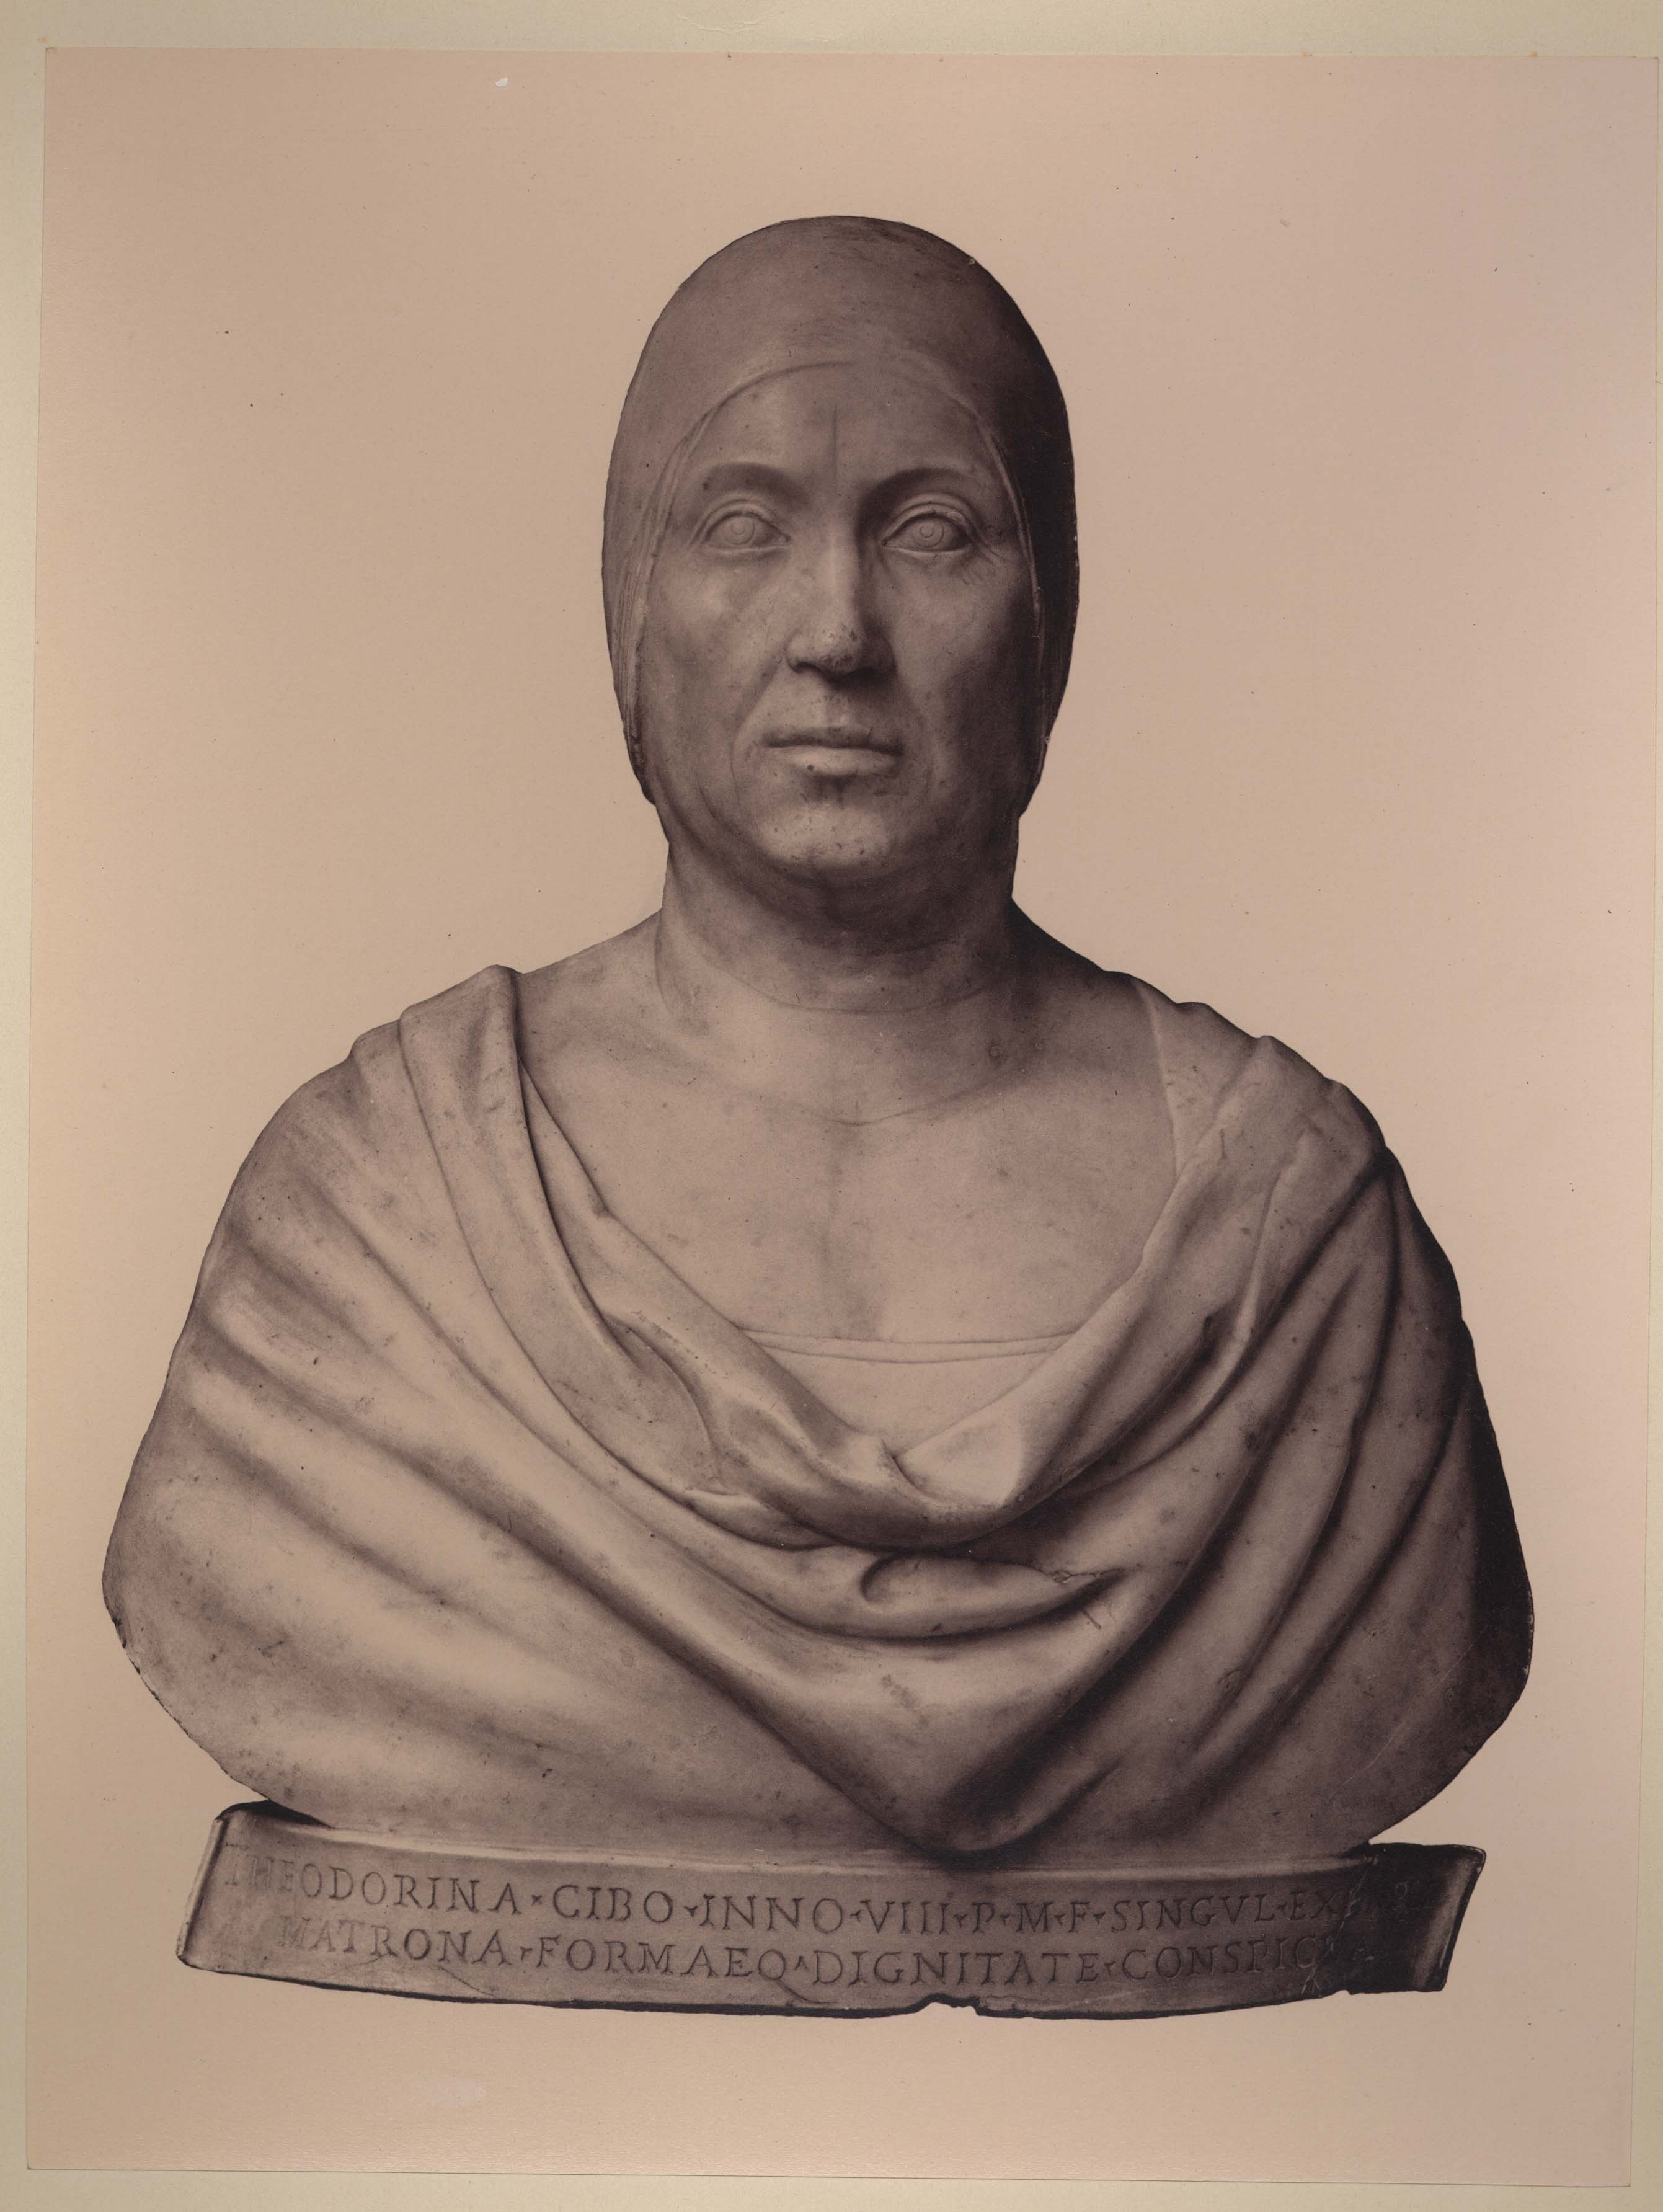
Further investigations
Anonimo <1855-1920>. 1855. [Busto Di Teodorina Cibo Di Gian Cristoforo Romano : Staatliche Museen, Skulpturensammlung : Berlino. sup 2800 – PA Germania 006
What it would be useful to have

Slide 13
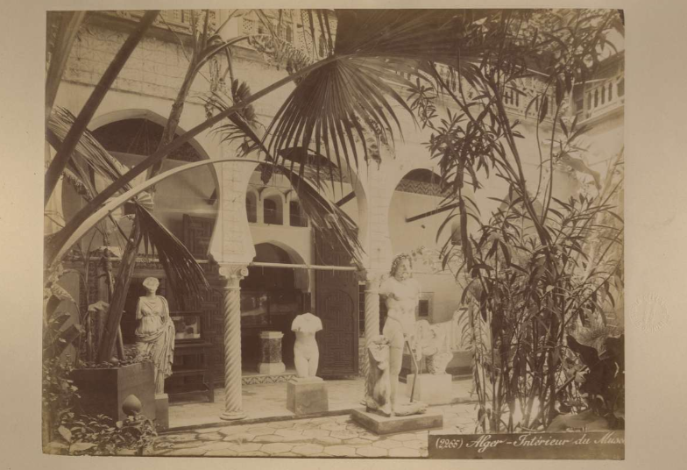
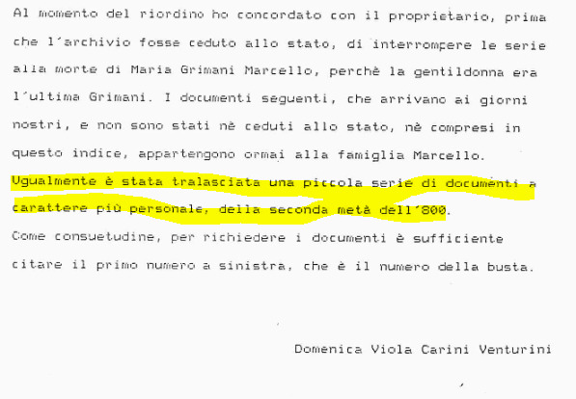
Wish list
Etienne Neurdein, Alger : 271 : Intérieur Du Musée : Vue Panoramiques (Neurdein, Etienne, 1845). sup 3149 – PA Algeria 012
Photos, photographers and historical archival focus
Annotations related to F entries
AF ID for authorities
Possibility to query other photo archives by negative number (or visual search)
References and links to named entities in annotations, es.: Countess Marcello (nee Grimani) = 'Maria Grimani Giustinian' http://dati.san.beniculturali.it/SAN/complarc_GGASI_san.cat.complArch.52480
Notes:
photograph’s item level metadata, is instead reported to the work-manifestation-item level of the represented work of art in the OA entry.
= having other copies of the same photos with more data es. for anonymous but professional photos

Slide 14
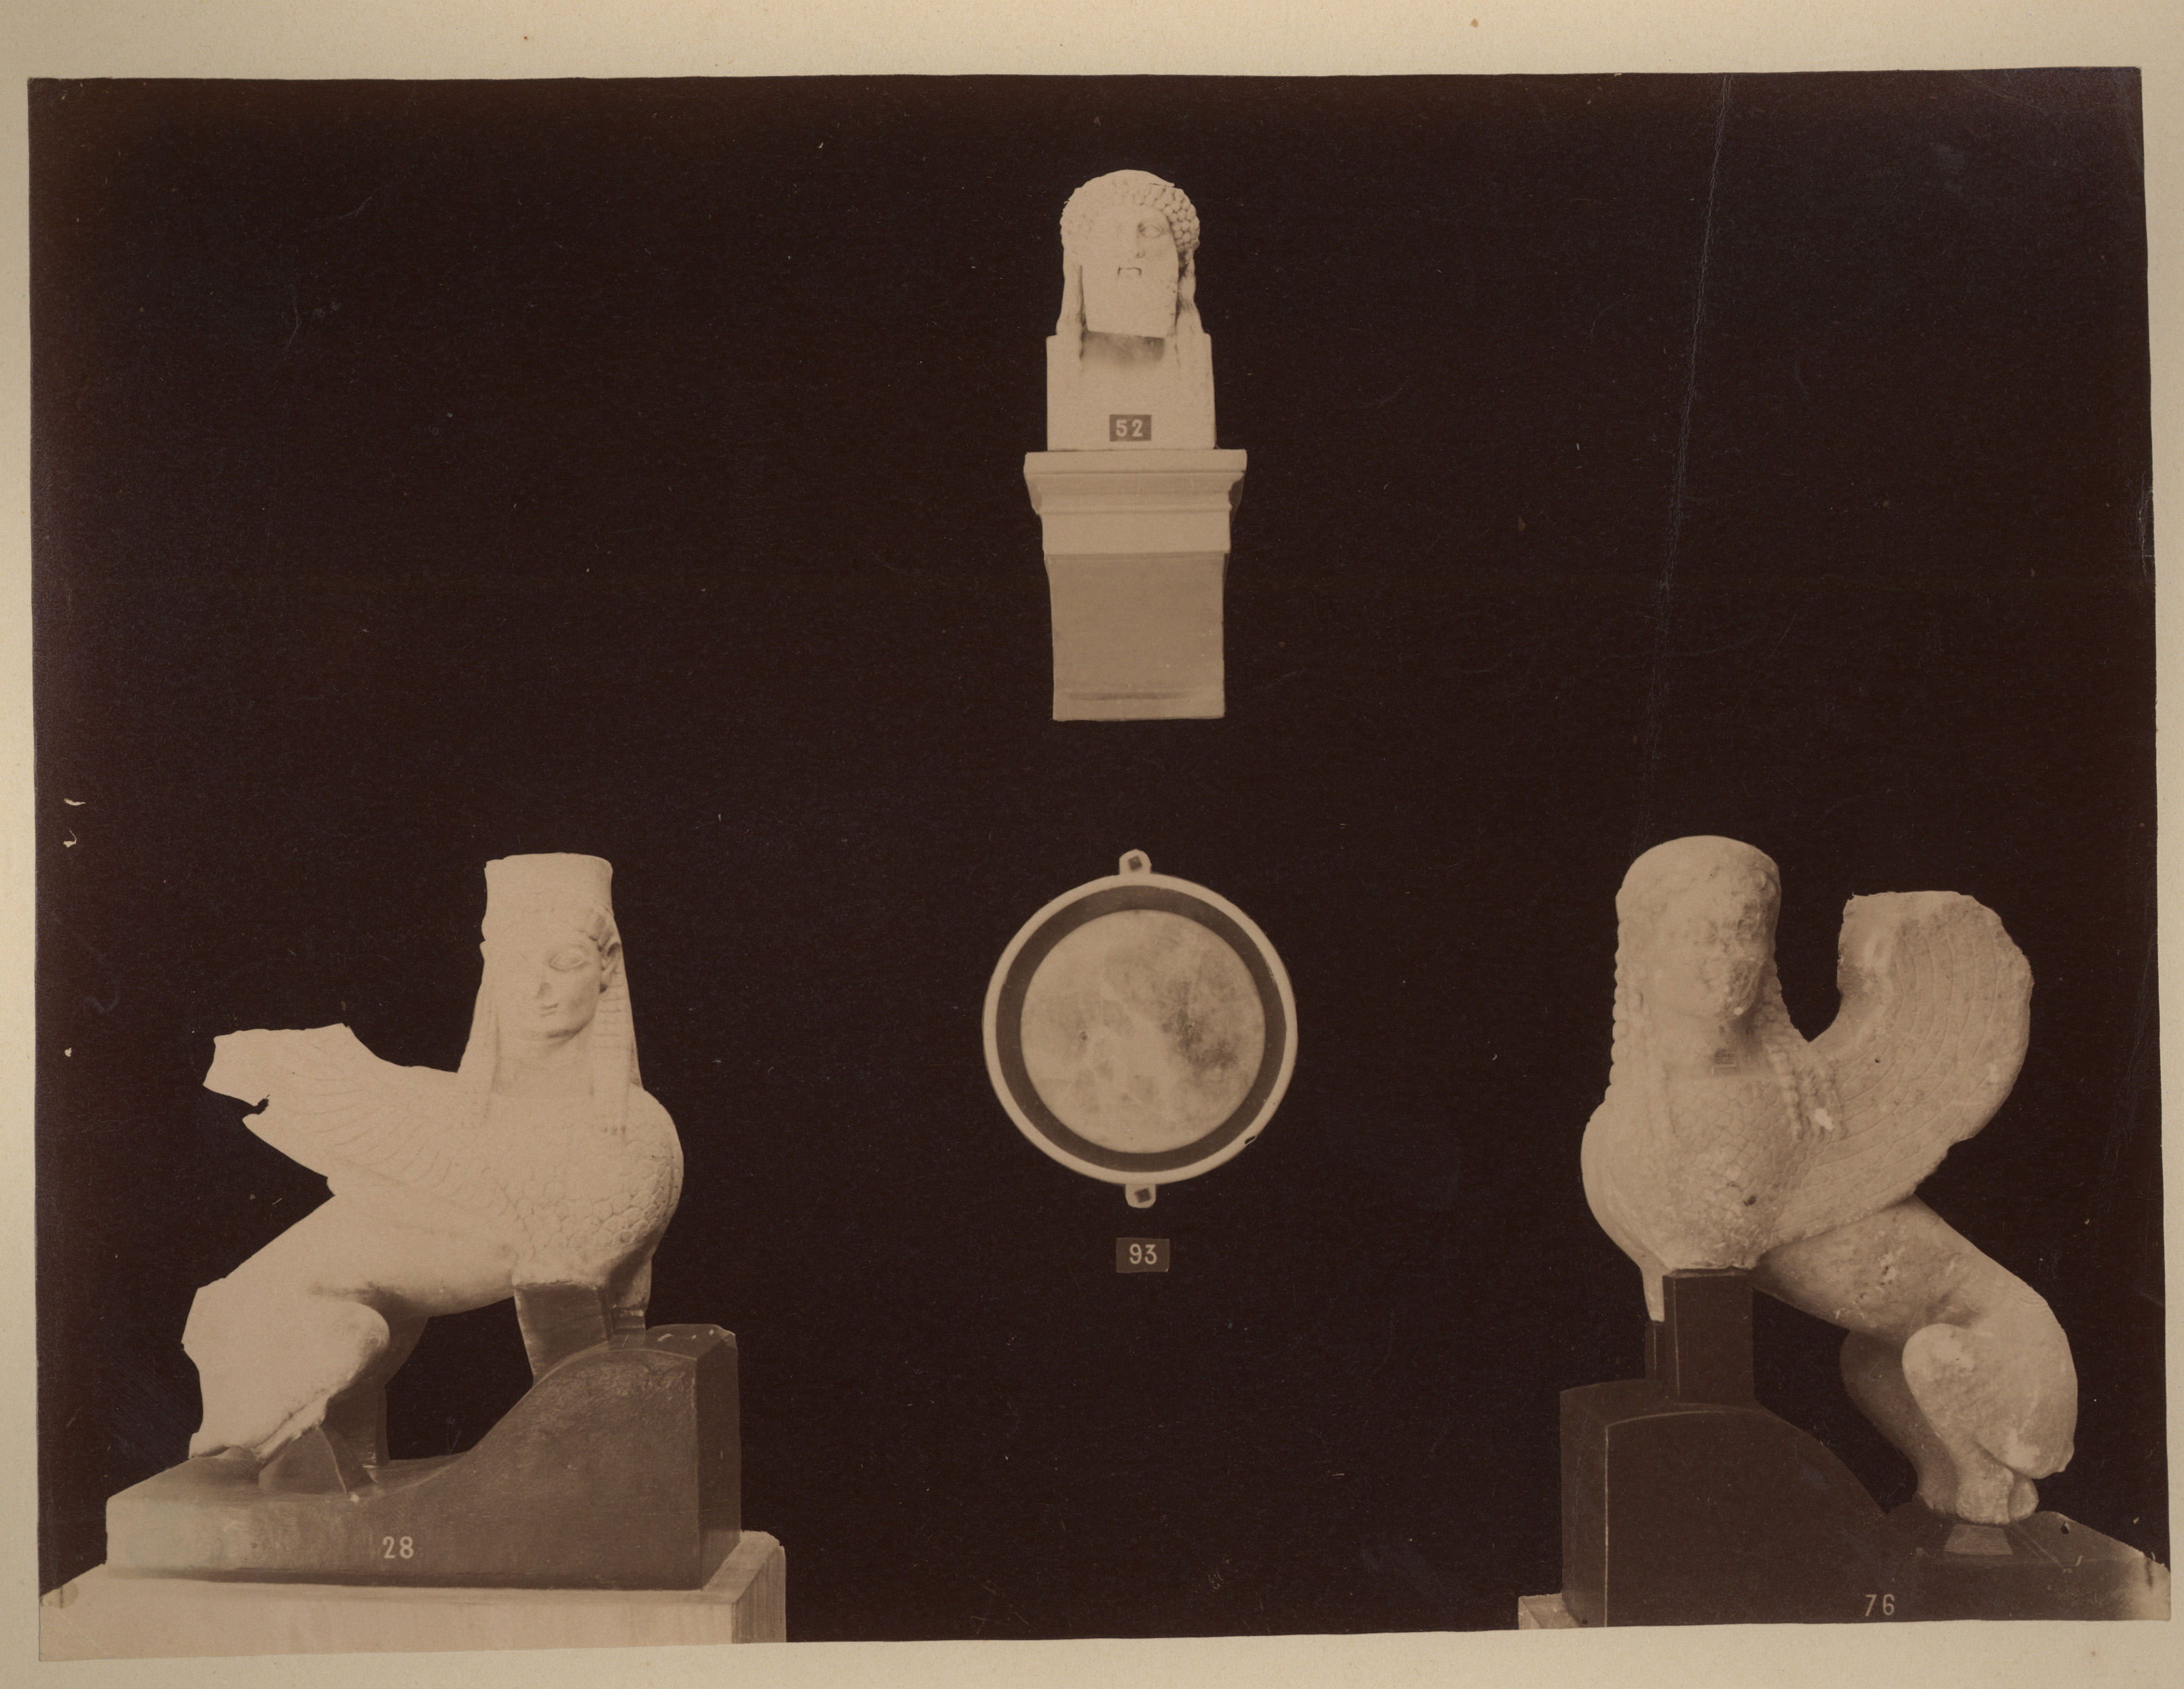
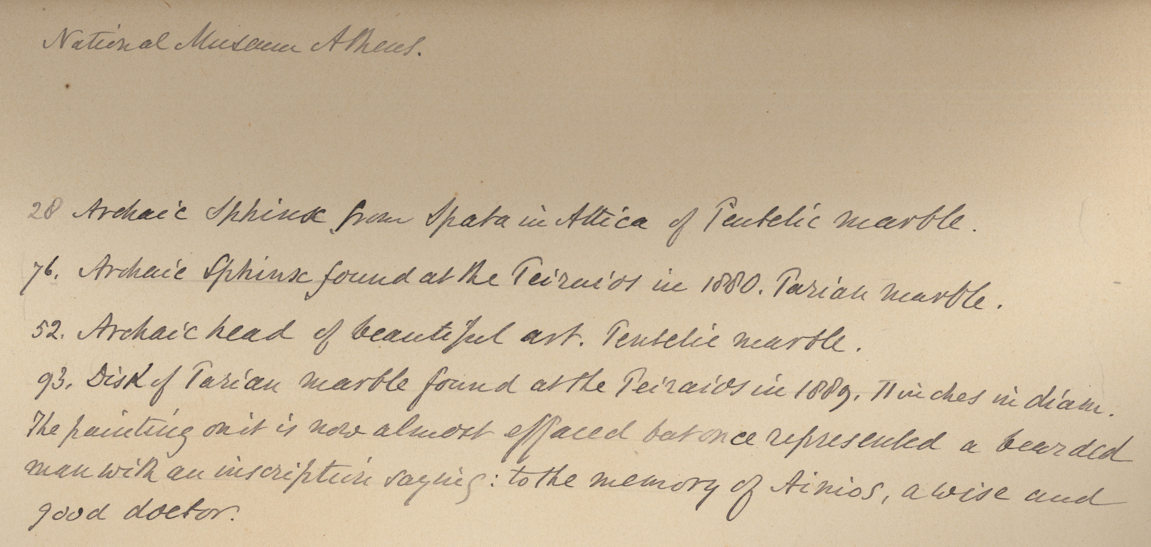
Thank you
Anonimo <1855-1920>. 1890. [Sfinge Arcaica in Marmo Pentelico Proveniente Da Spata, Sfinge Arcaica in Marmo Pario Trovata Nel Pireo, Testa Arcaica in Marmo Pentelico e Disco Di Marmo Pario Trovato Sul Pireo : Museo Archeologico Nazionale : Atene. sup 2832 – PA Grecia III 051
Keep on looking for…
and to:
Alma Mater Studiorum Università di Bologna
Biblioteca delle Arti Federico Zeri Foundation
Archivio Storico
AlmaDL

